Slide 1

Artificial Intelligence (AI101B)
Even Semester Session 2024-25
Speech-to-Text Conversion
Udit Ranjan 202410116100229
Suchita Singh 202410116100212
Shyam Sundar 202410116100207
Shweta Patel 202410116100206
Project Supervisor: Ms. Komal Salgotra (Assistant Professor)

Slide 2
Introduction
Implements speech-to-text in Python using Google’s Web Speech API.
Supports pre-recorded audio and real-time microphone input.
Applications: • Voice Note-Taking • Speech-Based Virtual Assistants • Automated Transcription
Features: • Format conversion (MP3/OGG to WAV) • CLI-based user interface • Robust error handling for unclear speech and connectivity issues

Slide 3
Methodology
Module 1: File-Based Transcription
• Upload via Google Colab
• Detect file format
• Convert to WAV (pydub + ffmpeg)
• Transcribe using recognize_google()
• Handle silent audio & API issues
Module 2: Real-Time Microphone Input
• Choose microphone via CLI
• Calibrate for ambient noise
• Transcribe & handle errors

Slide 4
Code
Install dependencies: SpeechRecognition, pydub, ffmpeg
Upload file and detect format
Convert to WAV if necessary
Use speech_recognition to load and transcribe audio
Add CLI for microphone input
Handle errors: unknown audio, API failure, or ambient issues

Slide 5
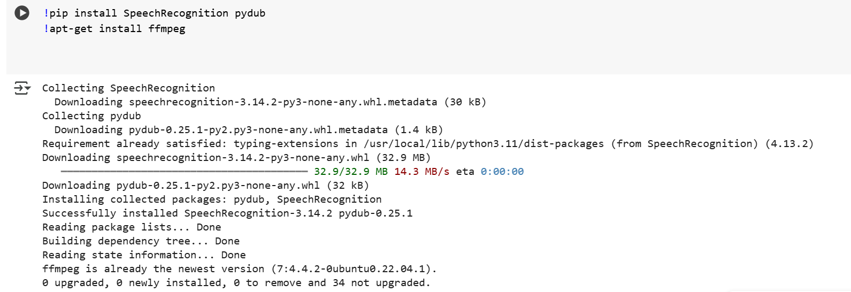
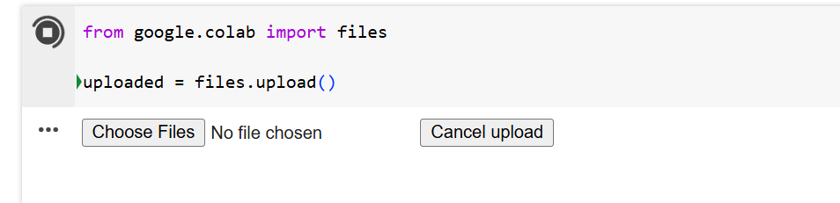
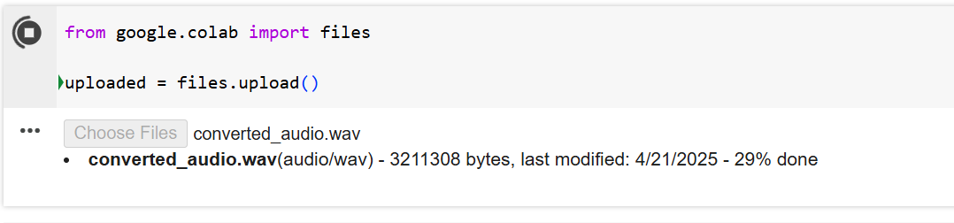
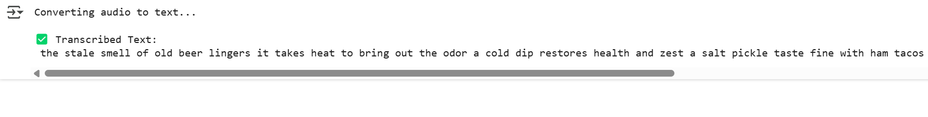
Output Screenshots

Slide 6
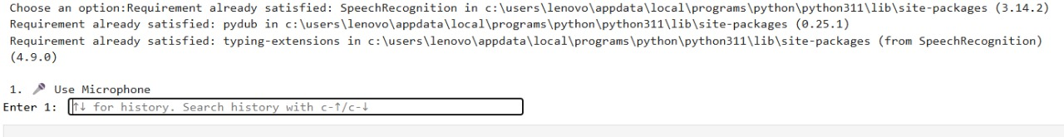
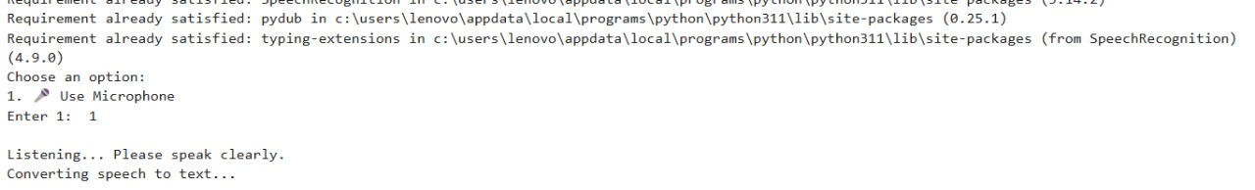
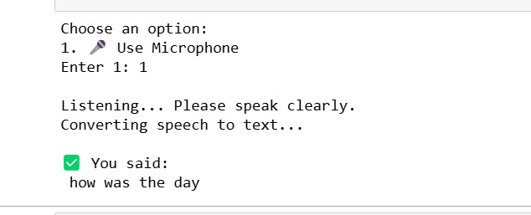
Output Screenshots

Slide 7
Conclusion
Supporting audio files.
Have real-time speech recognition (live mic input)
Auto-conversion to WAV ensures compatibility.
Google’s API ensures accurate transcription.
CLI design for simplicity.

Slide 8
THANK YOU

